Slide 1
Problem Statement
Quest for understanding of private blockchain performance
Design a general benchmark framework to find out to what extent can blockchain handle data processing workload.

Slide 2
Problem Statement
Quest for understanding of private blockchain performance
Design a general benchmark framework to find out to what extent can blockchain handle data processing workload.
Our framework will:
Help blockchain application developers to assess blockchain’s potentials in meeting the application needs.
Help blockchain platform developers to identify and improve on the performance bottlenecks.

Slide 3
Related Works
TPC benchmark series
End-to-end macro-benchmarks
Focus on relational data model
Yahoo! Cloud Serving Benchmark (YCSB)
For NoSQL data storage
To evaluate performance and scalability
GridMix, PigMix, TeraSort/GraySort, etc.
Benchmark for MapReduce-like systems
BigBench
Industry standard end-to-end benchmark
For big data processing systems
No benchmark for private blockchains at the moment

Slide 4
Outline
Introduction
Backgrounds
Problem Statement
Related Works
BlockBench Framework
System Design
Implementation
Performance Benchmark
Macro Benchmarks
Micro Benchmarks
Discussion
Conclusion

Slide 5
Challenges
Three main challenges
Challenge 1: a blockchain system comprises many parts, we observe that a wide variety of design choices are made among different platforms at almost every single detail.
Approach: We extract the common modules of blockchain platform, and divide the blockchain architecture into three modular layers and focus our study on them: the consensus layer, the data model layer and smart-contract execution layer.

Slide 6
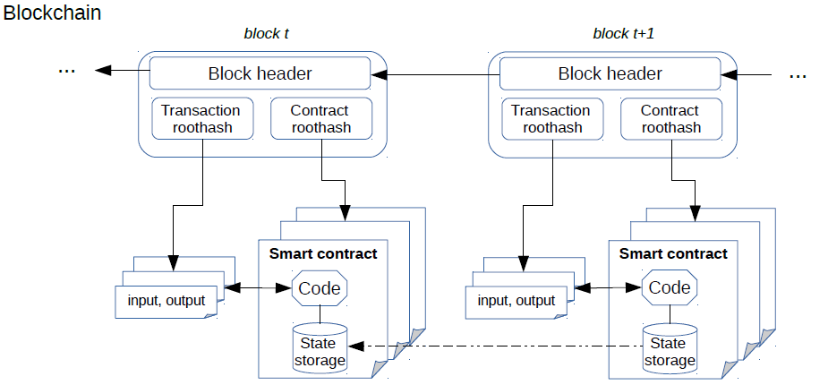
Challenges
Consensus Layer (PBFT, PoW, PoS, etc.)
Smart Contract Execution Engine (Virtual Machine, Docker, etc.)
Data Model Layer (LevelDB, RocksDB, etc.)

Slide 7

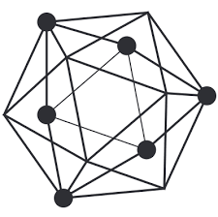

Challenges
Three main challenges
Challenge 2: there are many different choices of platforms, but not all of them have reached a mature design, implementation and an established user base.
Approach: We start designing BlockBench based on three most mature platforms which support smart-contract funcionality, namely Hyperledger Fabric, Ethereum and Parity, and the framework is general to support future platforms.

Slide 8
Challenges
Three main challenges
Challenge 3: There is lack of a database-oriented workloads for blockchain.
Approach: We treat blockchain as a key-value storage coupled with an engine which can realize both transactional and analytical functionality via smart contracts.
We design and run both transaction and analytics workloads in our benchmark framework.

Slide 9
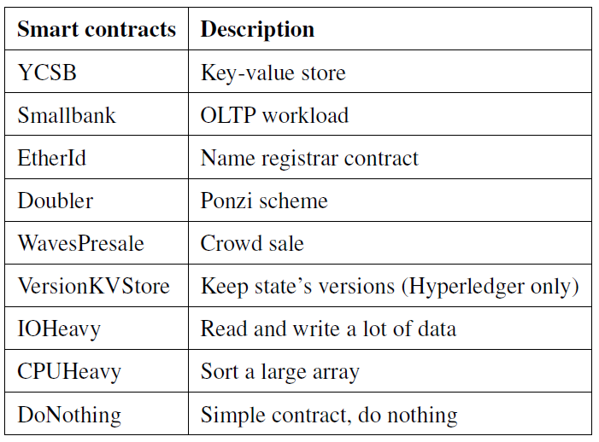
Workloads
Storage-oriented
Macro-Benchmarks
Application-oriented
Data model
Micro-Benchmarks
Execution engine
Consensus layer

Slide 10
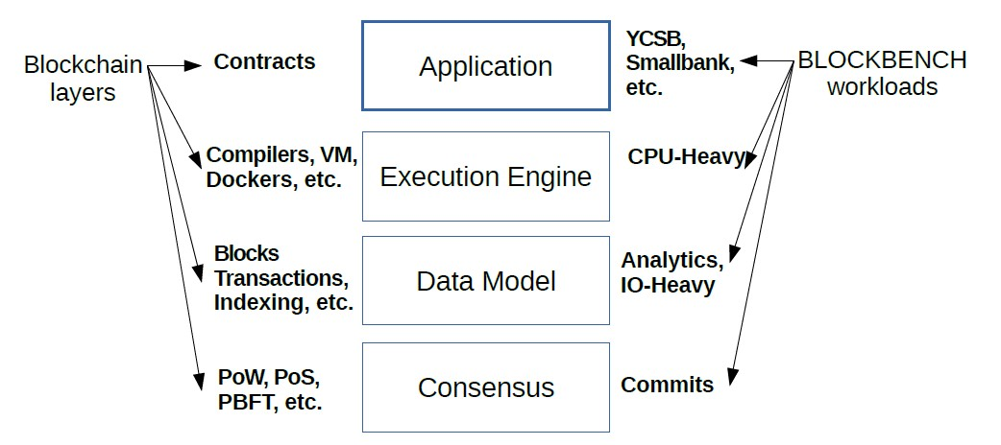
Framework Design

Slide 11
Workloads
Storage-oriented
Macro-Benchmarks
Application-oriented
Data model
Micro-Benchmarks
Execution engine
Consensus layer

